Slide 1
Stress and Memory: 1
Dr. Sarah N. Garfinkel
Brighton and Sussex Medical School
Applied Cognitive Psychology

Slide 2
Stress & Memory
Complicated!
Stress can facilitate memory
Stress can impair memory
How and why?

Slide 3
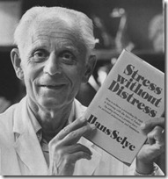
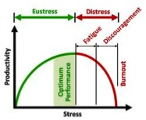
Key Stress Physiologists
Hans Selye devised the word “stress”.
In 1956, he published The Stress of Life and defined stress as "the non-specific response of the body to any demand made upon it, whether it is caused by, or results in, pleasant, or unpleasant conditions".

Slide 4
Definition?
No universal definition of stress.
“A perceived threat to homeostasis and as an event or stimulus that causes an often abrupt but always large change in autonomic activity and hormone secretion-particularly cortisol and prolactin” (Walkowitz & Rothschild, 2003)

Slide 5
Stress
Definition: Stress is the body's reaction to a change that requires a physical, mental or emotional response.

Slide 6
External and Internal Stressors
External stressors:
Physical conditions (e.g. pain, heat).
Stressful psychological environments (e.g. poor working conditions or abusive relationships)
Internal stressors:
Physical (infections, inflammation)
Psychological (i.e. intense worry)

Slide 7
Contributing factors to stress
Not all stressful events are stressful to every person:
Contributing factors:
Genetic predisposition
Gender (e.g. Menstrual cycle)
Perception of the stressor
Social support
Early life adversity

Slide 8
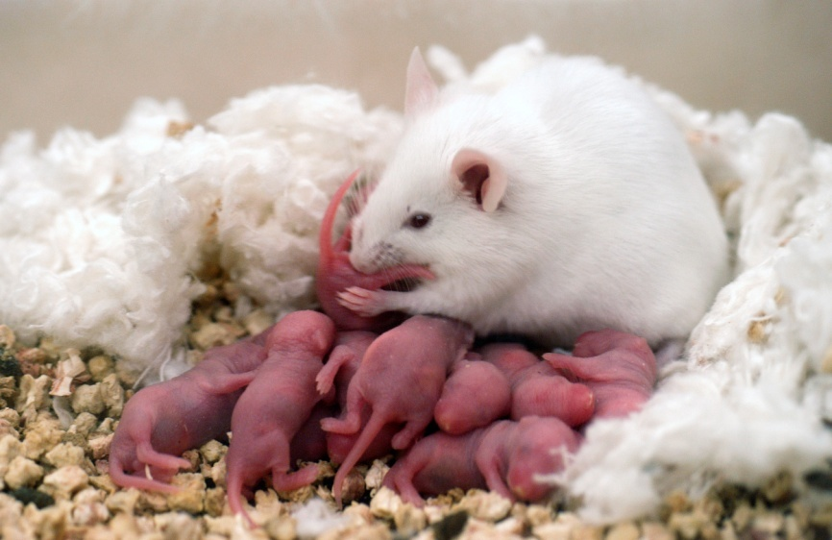
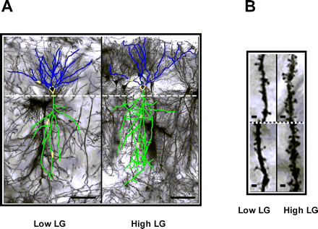
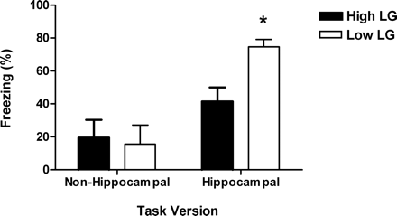
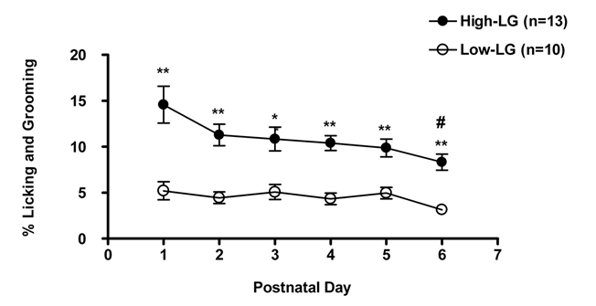
Maternal care and stress reactivity
Champagne et al., 2008
Notes:
Maternal licking and grooming (LG) in infancy influences stress responsiveness and cognitive performance in the offspring. We examined the effects of variation in the frequency of pup LG on morphological, electrophysiological, and behavioral aspects of hippocampal synaptic plasticity under basal and stress-like conditions. We found shorter dendritic branch length and lower spine density in CA1 cells from the adult offspring of low compared with high LG offspring. We also observed dramatic effects on long-term potentiation (LTP) depending on corticosterone treatment. Low LG offspring, in contrast to those of high LG mothers, displayed significantly impaired LTP under basal conditions but surprisingly a significantly enhanced LTP in response to high corticosterone in vitro. This enhanced plasticity under conditions that mimic those of a stressful event was apparent in vivo. Adult low LG offspring displayed enhanced memory relative to high LG offspring when tested in a hippocampal-dependent, contextual fear-conditioning paradigm. Hippocampal levels of glucocorticoid and mineralocorticoid receptors were reduced in low compared with high LG offspring. Such effects, as well as the differences in dendritic morphology, likely contribute to LTP differences under resting conditions, as well as to the maternal effects on synaptic plasticity and behavior in response to elevated corticosterone levels. These results suggest that maternal effects may modulate optimal cognitive functioning in environments varying in demand in later life, with offspring of high and low LG mothers showing enhanced learning under contexts of low and high stress, respectively.

Slide 9
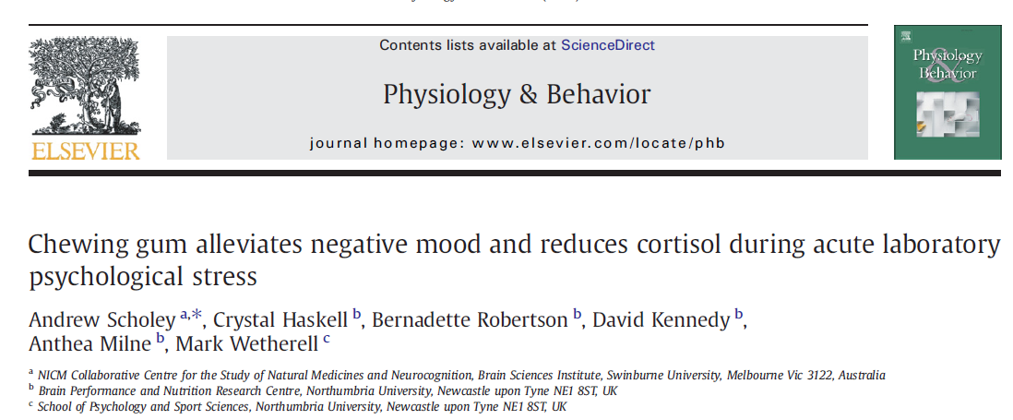
Chewing gum....
Mechanism ?

Slide 10
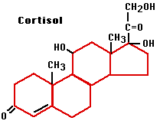
Cortisol
Hypothalamus
-
Cortisol in a steroid hormone, or glucocorticoid and released in response to stress.
Corticotropin releasing hormone (CRH)
Anterior pituitary
-
Adrenocorticotropin (ATCH)
Adrenal cortex
Inhibits
Cortisol

Slide 11
Stress and memory - Flashbulb memory?

Slide 12
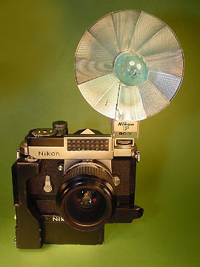
Flashbulb Memories
Gadget popular in the 50s and 60s: cameras were fitted with terminals to accept various types of flash bulbs.
“Distinctly vivid, precise, concrete, long-lasting memories”
September 11th : Attack on the World Trade Centre

Slide 13
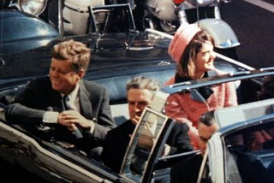
Where were you?
Assassination of JFK in 1963: Sparked first scientific study of flashbulb memories.
Harvard researchers Roger Brown and James Kulik noticed that people had particularly vivid memories of where they were when JFK was shot.
Brown & Kulik (1977), Cognition: “it is very like a photograph that indiscriminately preserves the scene in which each of us found himself when the flashbulb was fired”.

Slide 14
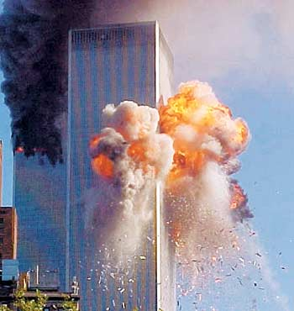
Confidence, not consistency
Talarico & Rubin (2003) Confidence, not consistency characterizes flash bulb memories.
54 Duke students recorded their memory of first hearing about the attacks of September 11th and of a recent everyday event.
They were tested again either 1, 6, or 32 weeks later.
Consistency, vividness and belief of accuracy in the memory were all assessed.

Slide 15
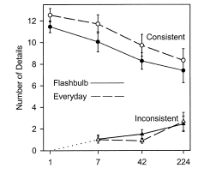
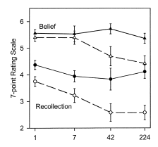
Confidence, not consistency...
Talarico & Rubin (2003)

Slide 16
Confidence not consistency...
Initial visceral emotion ratings correlated with later belief in accuracy, not consistency for flashbulb memories.
Initial visceral emotion ratings also predicted later posttraumatic stress disorder symptoms.
Flashbulb memories are not special in their accuracy, as previously claimed, but only in their perceived accuracy.
Mystery is why they are not so accurate, but why people are so confident in their accuracy.

Slide 17
Acute cortisol administration and/or stress can facilitate memory.....

Slide 18
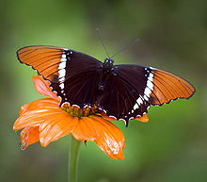
Emotion & Cortisol
Kuhlmann & Wolf (2006)
10 Neutral, 10 Positive, 10 Negative IAPS pictures
Shown for 3 sec
Subjects given either 30mg hydrocortisone (cortisol) or placebo .
Immediate and delayed memory testing
Notes:
subjects received placebo. On the first day, subjects signed the consent and

Slide 19
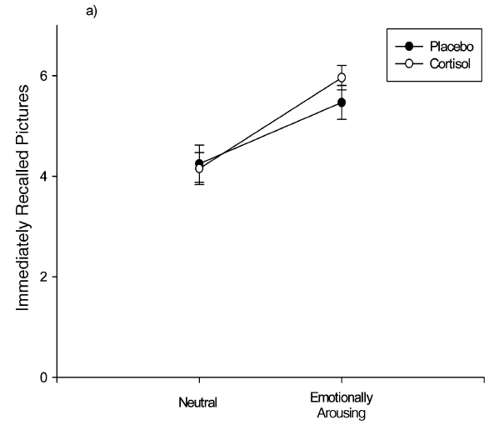
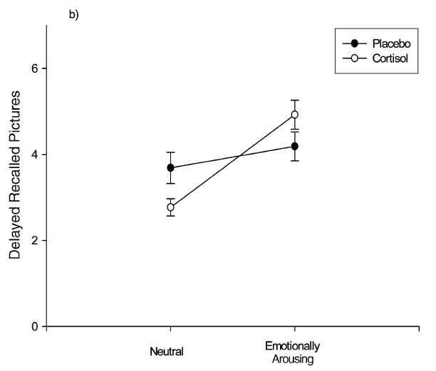
Arousal & Emotion

Slide 20
Cortisol & Emotion
Cortisol enhanced long term consolidation of emotional stimuli while also impairing consolidation of neutral stimuli.
The sum of correctly recalled slides did not differ between the two treatment groups, but the emotional enhancement was much stronger in the cortisol group.

Slide 21
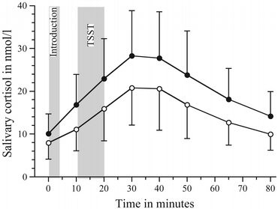
TSST: Trier Social Stress Test
Developed in Trier, in Germany (Kirschbaum, Pirke, Hellhammer 1993).
Psychological procedure that allows experimenters to induce stress under laboratory conditions
Speech & maths component
Pannelists

Slide 22
Negative Affect & Stress
Speech test (variant of TSST) administered POST encoding.
5 mins anticipation
15 mins public speaking (emotional reactions to pictures presented during encoding).
Abercrombie et al., (2006): Positive, negative & neutral IAPS pictures.
Self-reported negative affective experience (NA) was measured at baseline and immediately after the speech stressor using the Positive Affect and Negative Affect Schedule (PANAS State Version, Watson et al., 1988).
Free recall & recognition post stress

Slide 23
Negative Affect
Abercrombie et al., 2006

Slide 24
Need for arousal..?
Consistent with animal literature that suggests that glucocorticoid effects on learning require emotional arousal (Okuda et al., 2004).
Stimuli typically presented do not consistently evoke emotional arousal: in those men who experience negative emotional arousal related to the stressor, cortisol is more likely to affect memory performance.

Slide 25
The effect on memory of acute cortisol administration and/or stress is demonstrated with specific types of memory testing...

Slide 26
Buchanan & Lovallo, (2001)
Cortisol administration: 20mg, 1 hour prior to encoding.
IAPS pictures (positive, neutral negative).
Incidental memory tested one week later.
Memory assessed using free recall, cued recall (categories) and recognition.
Elevated cortisol levels during memory encoding enhanced long-term recall performance of emotionally arousing pictures (relative to neutral pictures).

Slide 27
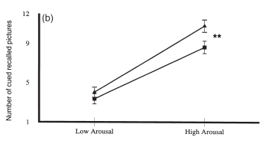
Arousal:

Slide 28
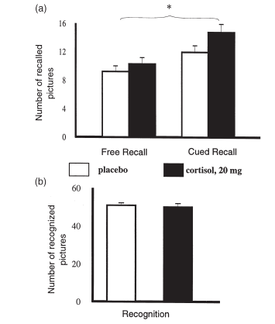

Slide 29
Acute cortisol administration and/or stress can impair memory.....

Slide 30
Cortisol Impairs Retrieval
- 14 Right handed male students given either placebo or cortisol (double blind, repeated measures): Learnt 20 word pairs.
- Next day: 25 mg cortisone or placebo (memory testing)
Cortisol impaired declarative memory retrieval.
Cortisol induced a large decrease in rCBF in the right posterior MTL (i.e. Parahippocampal gyrus), the left visual cortex and the cerebellum.
Cortisol did not induce performance differences on other tasks.
de Quervain et al., 2003

Slide 31
Autobiographic Memory
Lab based studies: Generalize to autographical memories?
22 male students: Placebo controlled double blind cross-over study (10mg hydorcortisone).
1 hour after administration, cortisol generated significantly fewer specific memories in the Autobiographical Memory Test (AMT).

Slide 32
AMT
Autobiographic memory cueing test (Williams & Broadbent, 1986).
Adjectives presented to participants (2 positive, 2 negative and 2 neutral).
Used to initiate memory retrieval (written / verbal)
Event took place at a certain place that did not last longer than a day. Told not to confabulate.
Specific vs. general? (location, time, people involved).

Slide 33
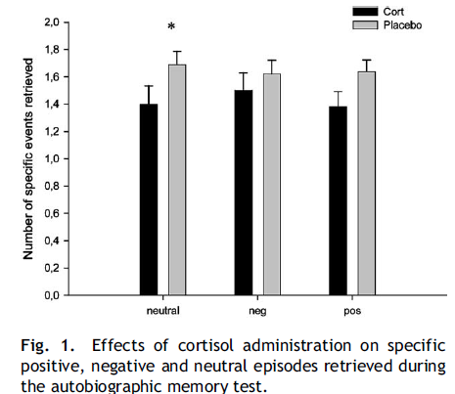
Autobiographic memory impairment

Slide 34
Autographical deficits: Depression
Autobiographical memory impairments are also observed in depressed and suicidal patients (Williams and Broadbent, 1986)
Depression is often accompanied by cortisol hypersecretion (Parker et al., 2003).
Could the autobiographic memory impairment in depression be due in part to glucocorticoid effects?

Slide 35
The effect on memory of acute cortisol administration and/or stress is modulated by time of day...

Slide 36
Het et al., (2005): Meta-analysis
- Acute stress: Differing effects on memory
Encoding
Consolidation
Retrieval
Time of day: Afternoon vs. Morning

Slide 37
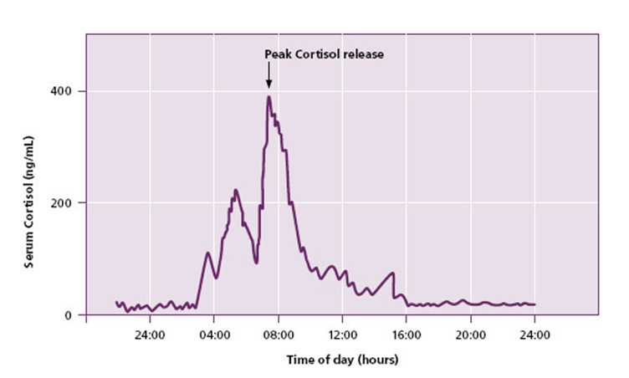
Time of day
Morning: High basal cortisol concentrations,
Afternoon: Low basal cortisol concentrations
(Lupien and Lepage, 2001; Lupien et al., 2002b)

Slide 38
The effect on memory of acute cortisol administration and/or stress is modulated by type of memory...?

Slide 39
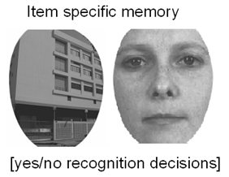
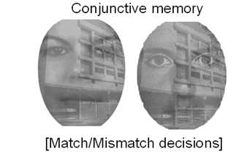
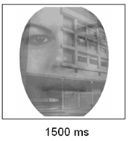
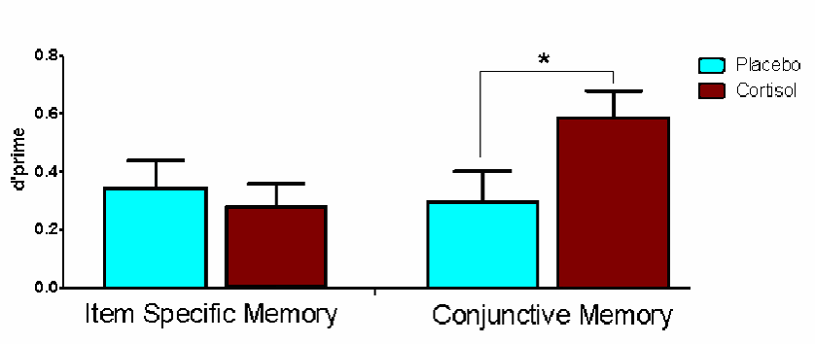
Type of memory?

Slide 40
Stress and memory
Flashbulb memories: Just more confident?
Early life adversity
Memory phase: Encoding, consolidation, retrieval
Time of day: Morning vs. Afternoon
Arousal level: Low vs. High arousal
Memory test (recognition vs. recall)
Type of memory...?
And more to be discovered!

Slide 41
Thank you.
ads
Applied Cognitive Psychology

