Slide 1
Mental Illness & Crime Key Issues & Debates (part 2) Dr Ann Henry
Forensic & Applied Cognitive Psychology

Slide 2
Recap re Lecture 1(last week)
Quiz on mental health awareness
Legal definition of sanity/ insanity
Mental Health Act 1983
Stigma & Mental Illness
Crime & Mental Illness

Slide 3
Lecture Overview
Different types of mental illness/ disorder
Criminal Justice System
Treatments in mental health settings

Slide 4
Legal definitions
Definition of Mental Disorder
Mental Health Act (1983)
Four legal categories of mental disorder included: Mental Illness, Psychopathic Disorder, Mental Impairment, Severe Mental Impairment. N.b. Mental Illness not defined under the Act.
Mental Health Act (2007)
Single definition of mental disorder “any disorder or disability of the mind”

Slide 5
Different types of mental illness/ disorder
Mental Health Professionals use one of two most commonly used diagnostic systems:
International Classification of Diseases 10th edition (ICD-10, World Health Organisation 1992)
Diagnostic & Statistical Manual of Mental Disorders– 4th revision (DSM-IV, American Psychiatric Association, 1994)
DSM-5 (due to be published in May 2013)
http://www.dsm5.org/Pages/Default.aspx

Slide 6
Different types of mental illness/ disorder
Schizophrenia
Bipolar Affective Disorders
Depression
Neurosis
Personality Disorders
Psychopathy
Substance Abuse Disorders
Learning Disability
Disorders of Sexual Preference (Paraphilias)

Slide 7
Common types of mental illness/ disorder
Neurotic disorders (mild/ moderate in severity)
low mood, excessive anxiety & worry.
Anxiety disorders
Phobias
Excessive-Compulsive Disorder
Depression
Insight – patient is usually aware he is unwell & needs treatment.
Can mostly function in society with treatment from GP & primary healthcare services.

Slide 8
Severe mental illness/ disorder
In the past referred to as ‘psychotic disorders’
Schizophrenia & Bipolar affective disorder are the most common in specialist forensic mental health settings (McMurran et al , 2009).
Prolonged periods of illness
Sufferer loses contact with reality in some way & experiences symptoms such as hallucinations & delusions.
Sufferer loses insight, so may be unaware that he is unwell.

Slide 9
Schizophrenia
Complex chronic mental illness characterised by disturbances in thinking, emotion, behaviour & perception (McMurran et al, 2009)
Prevalence of schizophrenia – 1% of the British population (Perala et al, 2007).Onset usually between age 15 & 45 years.
Positive symptoms (those present) – hallucinations & delusions. Respond well to anti-psychotic medication.
Negative symptoms (absent) – apathy, social withdrawal, slowness, poor self-care.
Paranoid Schizophrenia is the most common in the UK.

Slide 10
Schizophrenia
Persecutory or grandiose delusions –e.g. that God has sent the devil to take him to hell (persecutory), that his food is being poisoned (paranoid).
Hallucinations – mostly auditory.
Causation is unknown – however, it is thought to be a neuro-developmental disorder caused by complex interaction of both genetic & environmental factors.

Slide 11
Bipolar affective disorder
Severe mental illness with long periods of severe mood disturbance.
Mood disturbance at both polars
Episodes of mania (or hypomania) & depression
Approx 1% of population suffer from bipolar affective disorder.

Slide 12
Depression
Most common mental illness in general community settings & it is a major public health problem
Prevalence in UK is 10-20%
Women twice as likely to be affected than men
Major cause of absenteeism from work
Depressed mood, loss of interest & enjoyment, reduced energy & fatigue, reduced self-esteem & confidence, ideas of guilt & unworthiness, bleak & pessimistic views about future, ideas of suicide, disturbed sleep, decreased appetite (ICD-10)

Slide 13
Personality Disorders
In ICD-10 – 8 types of personality disorder
In DSM-IV – 10 types of personality disorder
In ICD-1O –
Cluster A – Paranoid, Schizoid
Cluster B – Dissocial (antisocial), Emotionally Unstable (borderline), Histrionic
Cluster C – Anankastic (OCD), Anxious (avoidant), Dependent

Slide 14
Personality Disorder & Offending
Coid et al (2006b)
Those with cluster B Personality disorders (antisocial, borderline, histrionic & narcissistic (DSM-IV) are more 10 times more likely than those in the general population to be violent.
Strong link between Antisocial Personality Disorder (Dissocial) and violence.
Cluster A (paranoid, schizoid) & Cluster C (OCD, Avoidant & Dependent) showed NO increased risk of offending.

Slide 15
Birmingham (2003, cited in McMurran et al, 2009)
 | Male % |  |  | Female%
ICD-10 | General | Remand | Sentenced | G | R | S
Psychotic Disorder | 0.5 | 10.0 | 7.0 | 0.6 | - | -
Neurotic Disorder | 12.0 | 59.0 | 40.0 | 18.0 | 76.0 | 63.0
Personality Disorder | 5.4 | 78.0 | 64.0 | 3.4 | - | -
Hazardous Drinking | 38.0 | 58.0 | 63.0 | 15.0 | 36.0 | 39.0
Drug Dependence | 13.0 | 51.0 | 43.0 | 8.0 | 54.0 | 41.0

Slide 16
Psychopathy
Definition is controversial
Not specifically defined in ICD-10 or DSM-IV
Closest is Antisocial Personality Disorder (Dissocial)
Assessed using Hare’s Psychopathy Checklist (Revised, 1991, 2003). Includes traits (grandiosity, selfishness, callousness) and behaviours (antisocial, irresponsible & parasitic lifestyle)
Higher scorers on PCL-R often begin their criminal careers earlier & more likely to reoffend

Slide 17
Psychopathy
Clinical psychopathy (measured by the PCL-R) is quite different to legal classification of ‘psychopathic disorder’,
Psychopathic Disorder referred to in the Mental Health Act (1983) refers to any personality disorder, not just psychopathy.

Slide 18
Dangerous & Severe Personality Disorder (DSPD)
This is an administrative, not psychiatric label.
To receive this label, offenders must fulfil the following criteria:
1) be assessed as ‘more likely than not’ to commit a serious violent of sexual offence
2) Have a severe personality disorder as defined by a high PCL-R score and/or a number of different personality disorder diagnoses
3) There should be a functional link between the personality disorder & the offending.
Duggan & Howard (2009)

Slide 19
Substance Abuse Disorders
History of substance abuse common among forensic populations
Singleton (1999) found that 63% of male (39% female) sentenced prisoners reported hazardous drinking the year before entering prison
30% of male (11% female) prisoners had severe alcohol problems
43% of male (42% female) prisoners reported moderate or severe drug dependence.
These figs are far in excess of general population

Slide 20
Learning Disability
Describes those with global impairment in intelligence.
Mild – IQ in range 50-69
Moderate – IQ in range 35-49
Severe – IQ in range 20-34
Profound – IQ less than 20
People with LD have increased risk of mental illness, behavioural problems, sensory deficits, neurological disorders e.g. epilepsy, physical health problems

Slide 21
Criminal Justice System
Ministry of Justice (MOJ)
The Home Office (HO)
Office of the Attorney General
The Police
Crown Prosecution Service (CPS)
Mental Health Acts (1983, 2007)
Courts (Magistrates & Crown)
National Offender Management Service (NOMS)
Prison Service
Hospital/Community Treatment
Criminal Justice Process (see scan on next slide, McMurran, Khalifa & Gibbon, 2009, p.3)

Slide 22
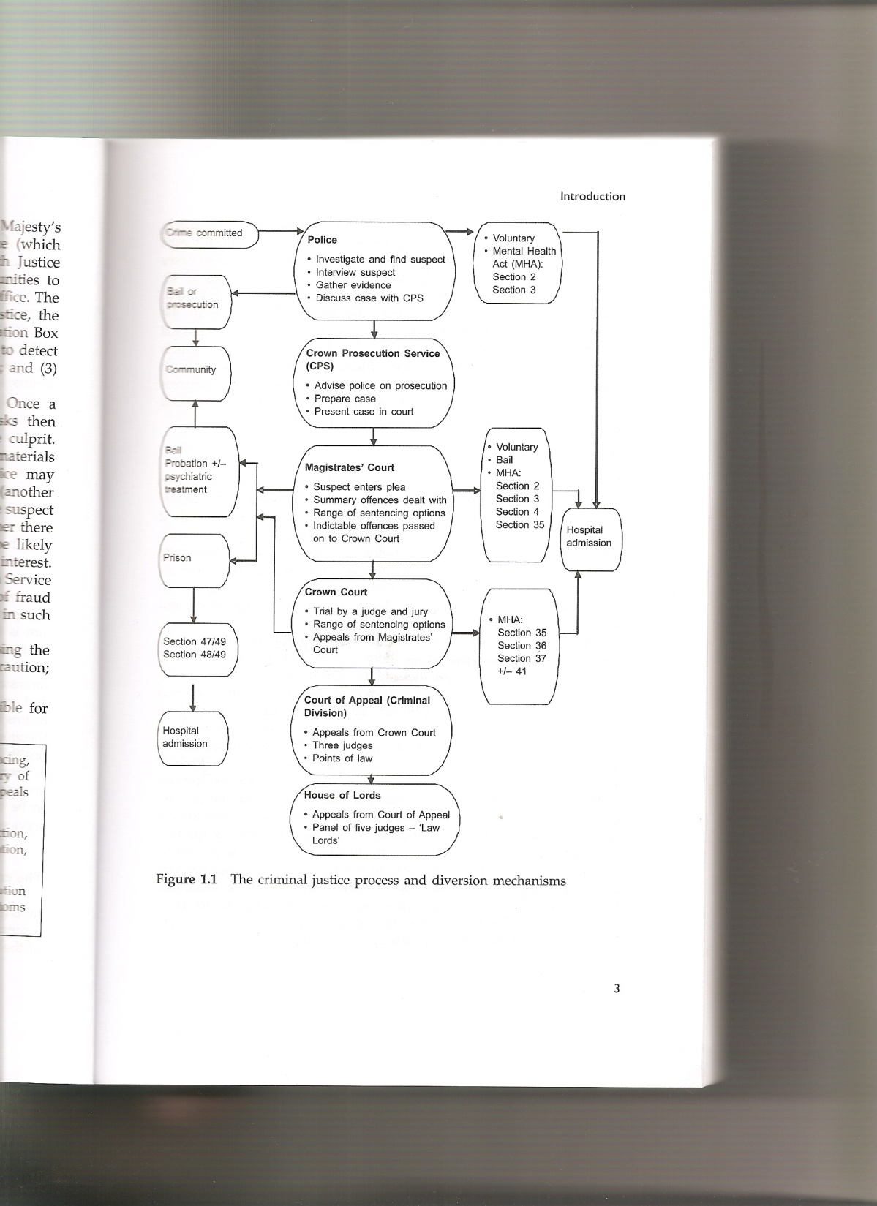

Slide 23
Criminal Justice System
Ministry of Justice (MOJ)
Responsible for criminal law & sentencing, reducing reoffending, prisons & probation. Oversees Magistrate’s courts, Crown Courts, the Appeals Courts & Legal Services Commission

Slide 24
Criminal Justice System
The Home Office (HO)
Office of the Attorney General
National Offender Management Service (NOMS)

Slide 25
Interventions in Prisons & Probation Services
What works? (Martinson, 1974)
Risk-Needs-Responsivity (Andrews & Bonta, 2003, Andrews et al ,2006)
In Prison -
Accredited Programmes: e.g. Enhanced Thinking Skills (ETS), Reasoning & Rehabilitation (R &R), Aggression Replacement Training (ART), Controlling Anger & Learning how to Manage it (CALM),Chromis (for DSPD), Substance Misuse, Action for Drugs, Drink Impaired Drivers etc.
http://www.justice.gov.uk/offenders/before-after-release/obp

Slide 26
Interventions: working with offenders in mental health settings
High Secure (Broadmoor, Rampton, Ashworth)
Medium Secure
Low Secure (Rehabilitation)
Types of Interventions
Pharmacological
Psychological
Social & Occupational

Slide 27
Interventions: working with offenders in mental health settings
Pharmacological Interventions
Antipsychotic medication for Schizophrenia
Antidepressants (SSRIs) for depression
Mood stabilisers (Lithium) for bipolar
National Institute of Health & Clinical Excellence (NICE) guidelines (2002)

Slide 28
Interventions: working with offenders in mental health settings
Psychological interventions
Cognitive-Behaviour Therapy (CBT) Approved in NICE guidelines
Dialectical Behaviour Therapy (DBT) especially for Borderline Personality Disorder
Cognitive Remediation Therapy (CRT) for schizophrenia
Family Therapy
Psychodynamic Therapy
Art, Drama, Music, Dance Therapies (less common)

Slide 29
Interventions: working with offenders in mental health settings
Social & occupational interventions
Occupational Therapy
Social Workers

Slide 30
Summary of Lecture
Different types of mental illness/ disorder
Criminal Justice System
Treatments in mental health settings

Slide 31
Useful references & websites
Bartlett, A. McGauley, G. (2010). Forensic Mental health, concepts, systems & practice. Oxford, Oxford University Press.
http://www.dsm5.org/Pages/Default.aspx
Her Majesty’s Prison Service
http://www.justice.gov.uk/about/hmps
Howitt, D. (2006). Introduction to Forensic & Criminological Psychology, Harlow, Pearson.
McMurran, M., Khalifa, N. & Gibbon, S. (2009). Forensic Mental Health, Devon, Willan Publishing.
Ministry of Health Act (1983, 2007)
http://www.legislation.gov.uk/ukpga/2007/12/contents
Ministry of Justice
http://www.justice.gov.uk/
National Probation Service
http://www.nationalprobationservice.co.uk/

Slide 32
Next Lectures…
Tuesday 13th November:
Theories of Crime: Sexual Offending (part 1)
Monday 19th November…NO LECTURE?
Tuesday 20th November:
Violent & Sexual Offending (part 2)

